Slide 1
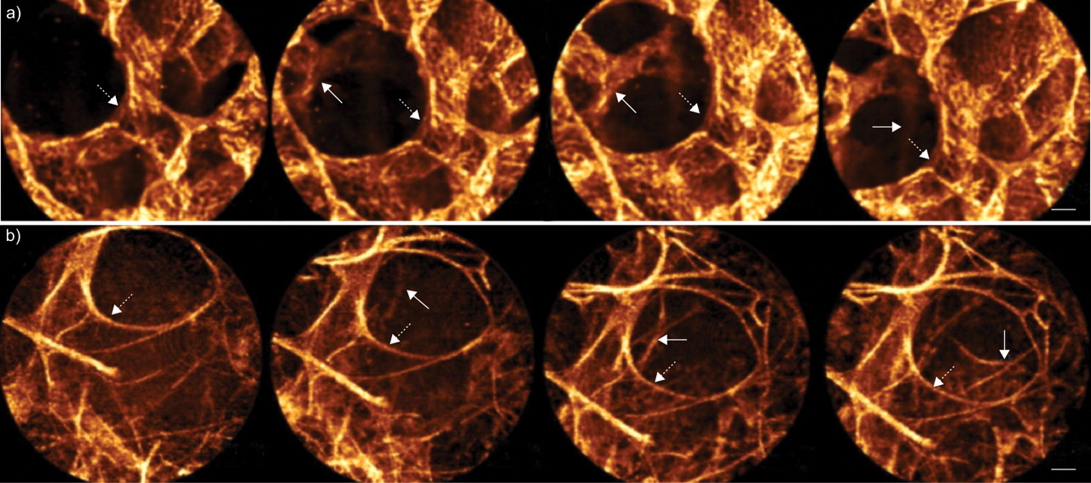
a) Ex vivo and b) in vivo consequences of a probe tip compression applied on the lung tissue in the axis of the alveolar duct.
L. Thiberville et al. Eur Respir J 2009;33:974-985
©2009 by European Respiratory Society
Notes:
a) Ex vivo and b) in vivo consequences of a probe tip compression applied on the lung tissue in the axis of the alveolar duct. From left to right: effect of increasing pressure on the tissue (see online video for the dynamic sequence). a) Ex vivo fixed sample. b) In vivo fibred confocal fluorescence microscopy images from a nonsmoking individual. Dashed arrows: edges of the alveolar duct; arrows: successive appearance of distant alveolar duct structures. Compression allowed for visualisation of deeper structures down the axis of the duct, providing a 3D-like effect, without perceptible deformation in the first plane of focus. Scale bars = 50 μm.

