Slide 1
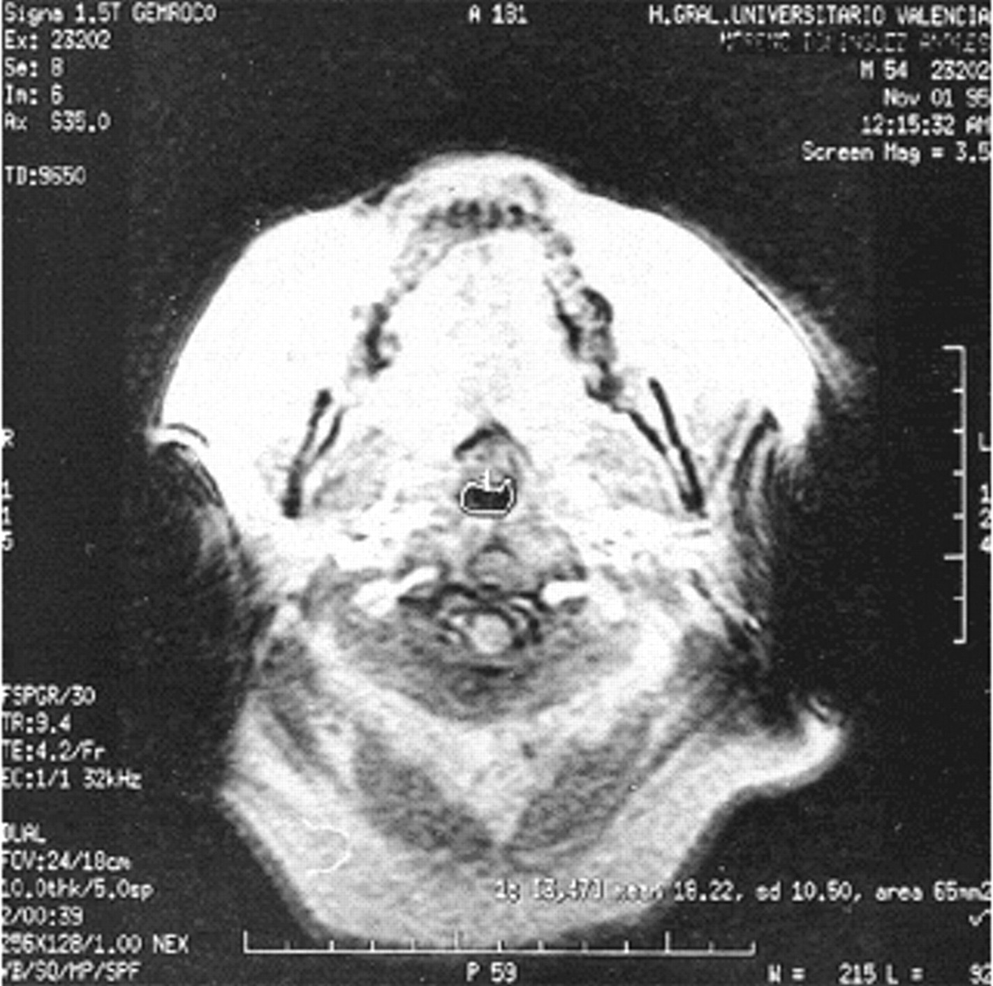
Axial magnetic resonance image of the velopharynx in which the area and parapharyngeal fat pads have been limited by hand generating a region of interest.
M.A. Ciscar et al. Eur Respir J 2001;17:79-86
©2001 by European Respiratory Society
Notes:
Axial magnetic resonance image of the velopharynx in which the area and parapharyngeal fat pads have been limited by hand generating a region of interest.

